Slide 1
Low Pass filter
Diego Banos Salavarría

Slide 2
What is?
A C program that takes an input file and returns the processed file.

Slide 3
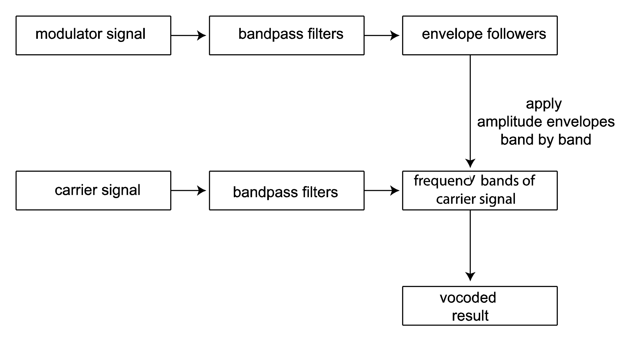
Why?

Slide 4
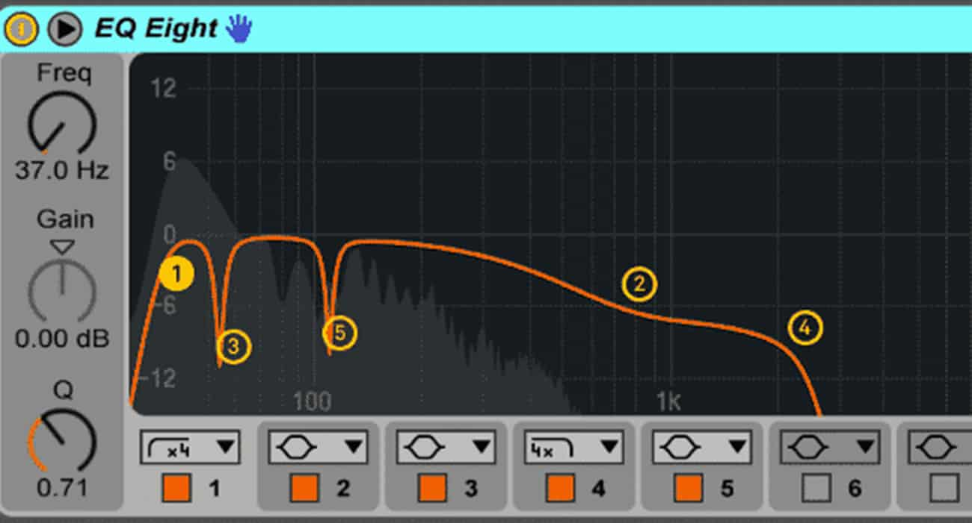
Why?

Slide 5
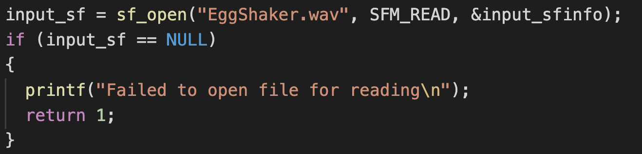
How?
Using sndfile.h
Reads an input file with sf_open

Slide 6
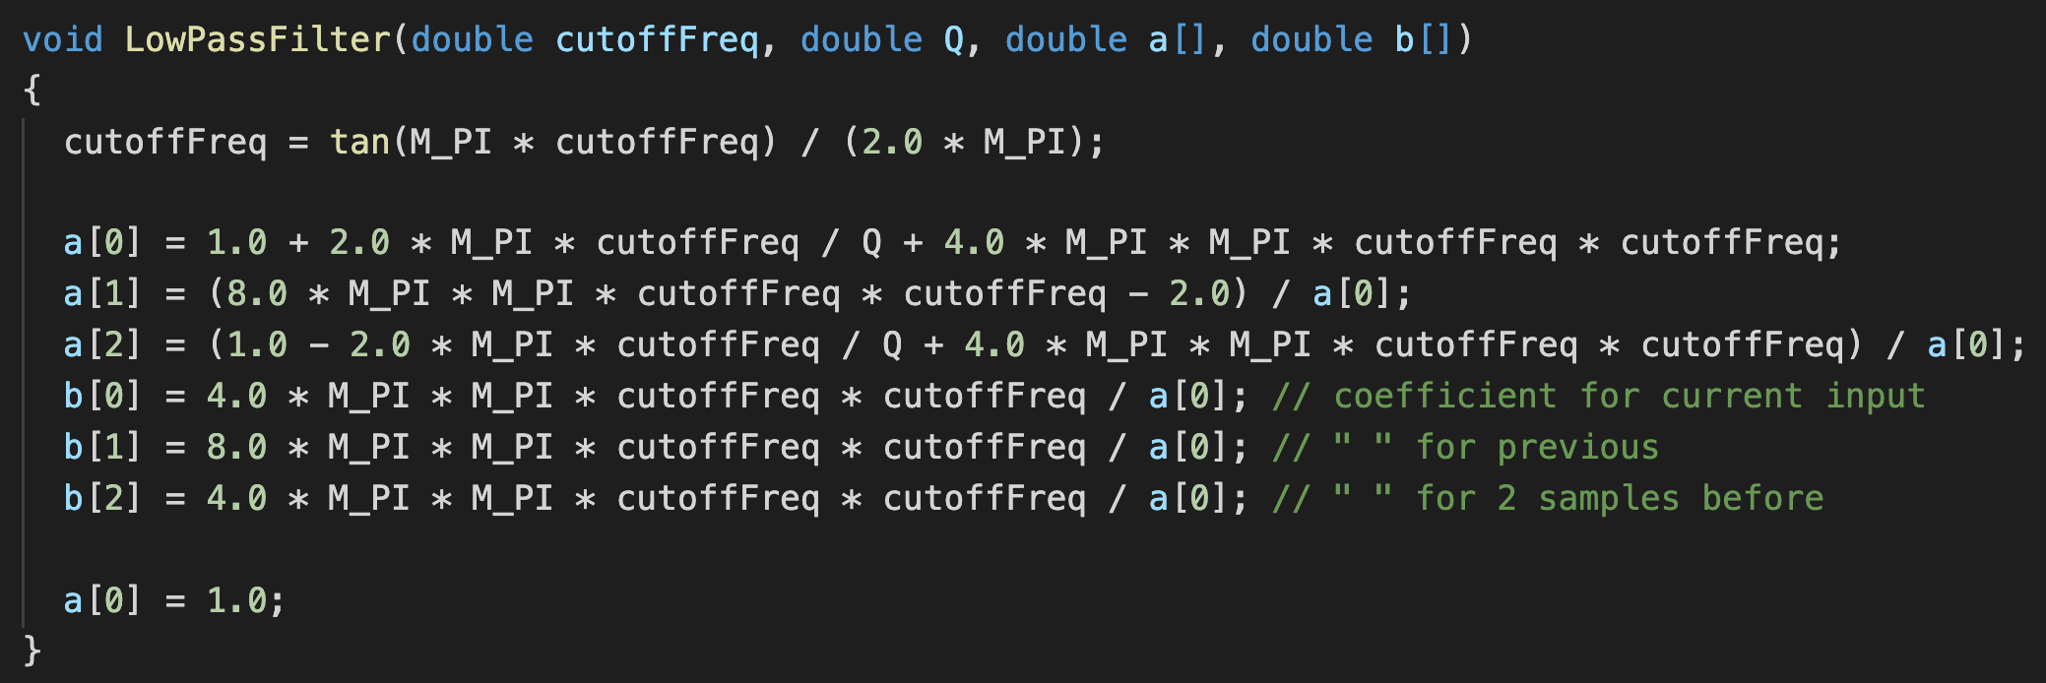
How?
Processes the file with LowPassFilter()

Slide 7
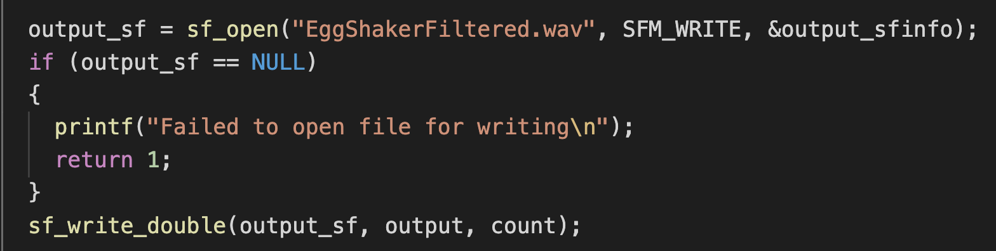
How?
After being processed, it writes a new file with the new audio using sf_open in write mode.

Slide 8
Demo!

Slide 9
What works? What does not work?
It does what it’s supposed to do, but maybe the output could be a bit more interesting.

Slide 10
Future Implementation
Creating other functions like: HighPassFilter(), BandPassFilter()
Making it stereo
Making it real time
Making an “EQ-3” tool

